Slide 1



01/16
PRESENTATION

Slide 2



02/16
WELCOME TO PRESENTATION

Slide 3



TABLE OF CONTENTS
03/16
01
Introduction and About Us
02
Problems and Solution
03
What We Offer
04
Competition's
05
Market Research
06
Our Team
07
Contact Us

Slide 4




04/16
INTRODUCTION
Our ecommerce platform is designed to empower small businesses by providing them with a user-friendly, secure, and reliable online presence. We understand the unique challenges faced by small businesses and are committed to helping them succeed in the digital marketplace.

Slide 5


05/16
ABOUT US
1.Empowering Small Businesses : Our ecommerce
platform is dedicated to helping small businesses thrive in
the digital age.
2.Seamless Online Presence : We provide a
hassle-freeway for small businesses to establish an
effective online presence.
3.Tailored Solutions : Our platform is designed with
the unique needs of small businesses in mind.

Slide 6


06/16
Problems
Limited Visibility: Reaching new customers and standing out in a crowded online marketplace can be a significant challenge.
Complex Integration: Seamlessly integrating ecommerce functionalities with existing systems and processes requires technical expertise.
Secure Transactions: Ensuring the security of customer data and online payments is crucial to building trust and credibility.
Abandoned Carts: Reducing the rate of cart abandonment and encouraging customers to complete their purchases is an ongoing issue.

Slide 7
07/16
Solutions
Limited Visibility:-
1.SEO Optimization: We will Improve their website’s search engine ranking through keyword optimization, quality content.
2.Social Media Marketing: Leverage platforms like Instagram, Facebook, and LinkedIn to reach a broader audience.
3.Influencer Partnerships: Collaborate with influencers to promote your products to their followers.
4.Content Marketing: Create valuable content such as blogs, videos, and infographics to attract and engage potential customers.
Complex Integration:-
1.API Solutions: We use APIs to integrate ecommerce functionalities with existing systems seamlessly.
2.Professional Services: We Hire experts or consult with firms specializing in ecommerce integration.
3.Modular Platforms: We choose ecommerce platforms that offer modular integration capabilities.
Secure Transactions:-
1.SSL(Secure Socket Layer) Certificates: We ensure that their website uses SSL certificates to encrypt data.
2.PCI Compliance: We use Payment Card Industry Data Security Standards (PCI DSS) to protect payment information.
3.Two-Factor Authentication: We Implement two-factor authentication for an added layer of security.
Abandoned Carts:-
1.Email Reminders: We will Send automated email reminders to customers who leave items in their carts.
2.Simplified Checkout: We will optimize the checkout process to reduce friction.
3.Incentives: We add offers, discounts or free shipping to encourage customers to complete their purchases.

Slide 8






WHAT WE OFFER
08/16
Responsive Designs
Customizable Branding
All websites created with our platform are mobile-friendly, ensuring a seamless user experience across devices.
Small businesses can incorporate their unique branding elements, such as logos, colors, and images, to create a distinctive online presence.
Shopping Cart and Checkout
Drag-and-Drop Interface
Customers can add desired items to their virtual shopping cart and proceed to a secure checkout process, where they can review their order, apply any discounts or promotions, and complete the transaction through a variety of payment options.
Our website builder features an intuitive drag and drop interface, making it easy for small business owners to customize their online store.
Product Catalog
Our website enable businesses to showcase their product offerings with detailed descriptions, high-quality images, and categorization for easy navigation. This allows customers to efficiently browse and discover items that cater to their needs and preferences.
Fraud Prevention
Our platforms implement advanced fraud detection and prevention measures, such as address verification, CVV checks, and transaction monitoring, to safeguard against unauthorized access and protect both businesses and customers from financial risks.

Slide 9
OUR Competition
09/16
Competitors in the Ecommerce Market:-
In the ecommerce market, our competitors include:-
Shopify,
Hostinger,
GoDaddy,
Framer AI,
Jimdo AI.
These existing players offer website creation services, but they have some limitations, such as:-
Limited flexibility in design.
Limited control over SEO.
Limited scalability for large websites.
Limited customization options.
Limited e-commerce features.
Tinor: A Unique Solution:-
Tinor stands out from the competition by offering a unique combination of:
Ease of use.
Affordability.
Customization options.
With Tinor, you can create a website that meets your specific needs without compromising on design, SEO, scalability, or e-commerce features.

Slide 10
Ai Generated vs Our Generated
10/16
Pros of Our made Websites:-
Unlimited Customization : Human-made websites offer unlimited customization options and flexibility to our customers.
Personalized Touch: Human-made websites have a unique and personalized touch that can be essential for businesses.
Advanced Functionality: Human-made websites can have advanced functionality and interactivity.
High-Quality Content: Human-made websites can have high-quality content that is engaging and informative.
Unique Design: Human-made websites can have a unique and creative design that stands out from the competition.
Cons:-
Time-Consuming: Human-made websites can be time-consuming to create and develop.
Expensive: Human-made websites can be expensive to create and maintain.
Limited Scalability: Human-made websites may have limited scalability and may require significant resources to scale up.
Human Error: Human-made websites can be prone to human error, such as coding mistakes or design flaws.
Maintenance: Human-made websites require ongoing maintenance and updates to ensure they remain relevant and functional.
Pros of AI-Generated Websites:
Speed: AI-generated websites can be created quickly, often in a matter of minutes.
Cost-Effectiveness: AI-generated websites can be created at a lower cost than human-made websites.
Scalability: AI-generated websites can be easily scaled up or down to meet changing needs.
Consistency: AI-generated websites can ensure consistency in design and layout.
24/7 Availability: AI-generated websites can be created and deployed 24/7, without the need for human intervention.
Cons:
Limited Customization: AI-generated websites may have limited customization options.
Lack of Human Touch: AI-generated websites may lack the human touch and creativity that a traditional website would have.
Dependence on Data: AI-generated websites are only as good as the data they are trained on.
Limited Functionality: AI-generated websites may have limited functionality and interactivity.
Quality Issues: AI-generated websites may have quality issues, such as poor design or content.

Slide 11


11/16
MARKET RESEARCH
Size of the Ecommerce Market in 2024:-
The global ecommerce market size is expected to reach $6.3 trillion in 2024, up from $5.8 trillion in 2023. The market is expected to continue growing, reaching $7.9 trillion by 2027.
Global Ecommerce Market Growth Rate:-
The global ecommerce market is expected to grow at a CAGR of 9.49% from 2024 to 2029, resulting in a projected market volume of $6,478.00 billion by 2029. The market's largest segment is Fashion, with a projected market volume of $1,444.00 billion by 2029.
Regional Growth Rates
The Asia-Pacific region is expected to have the highest growth rate, with a compound annual growth rate (CAGR) of 10.3% from 2024 to 2029.
The North American region is expected to have a CAGR of 8.2% from 2024 to 2029.
The European region is expected to have a CAGR of 7.5% from 2024 to 2029.
The Latin American region is expected to have a CAGR of 9.5% from 2024 to 2029.
The Middle East and Africa region is expected to have a CAGR of 11.2% from 2024 to 2029.

Slide 12


Target Markets
12/16
Who is Tinor For?
Small Businesses: Tinor is designed for small businesses that want to sell online and in-person.
Online Sellers: Tinor is suitable for online sellers who want to sell on social media, marketplaces, and other websites.
Retail Stores: Tinor is also suitable for retail stores that want to sell in-person and online.
Entrepreneurs: Tinor is a great platform for entrepreneurs who want to start an online business or expand their existing business online.

Slide 13
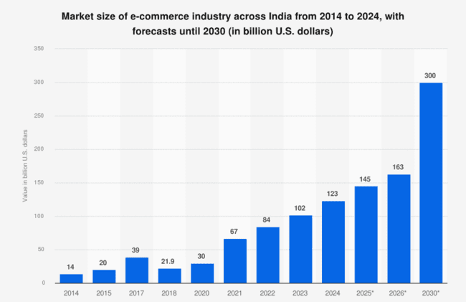
Notes:
revnene

Slide 14
Business or Revenue Model

Slide 15




Our Team
14/16
Team lead
Ronit Soni
Founder
Santosh Kumar Soni
Fronted Website Developer
B.SC.- I year Math
Higher Education

Slide 16





15/16
CONTACT US
Mochi Wada Ward No.45 Churu (Rajasthan)
+91 9887128798
ronitsoni506@gmail.com

Slide 17


16/16
THANK YOU
FOR WATCHING US

